Slide 1
Java Basics 8
Guangjian Zhou

Slide 2
What are the main benefits of new features introduced in Java 8?
forEach() method in Iterable interface
default and static methods in Interfaces
Functional Interfaces and Lambda Expressions
Java Stream API for Bulk Data Operations on Collections
Java Time API
Collection API improvements
Concurrency API improvements
Java IO improvements

Slide 3
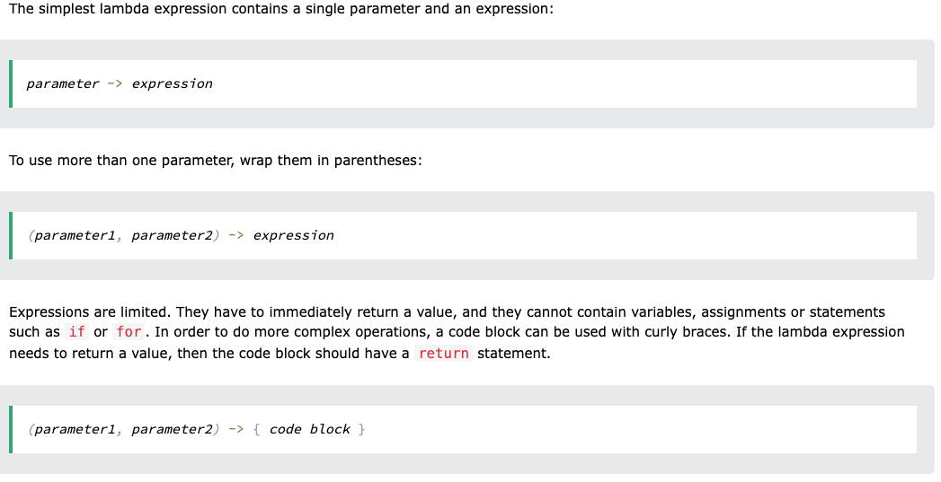
What is a Lambda expression in Java 8?
A lambda expression is a short block of code which takes in parameters and returns a value. Lambda expressions are similar to methods, but they do not need a name and they can be implemented right in the body of a method.

Slide 4
What are the three main parts of a Lambda expression in Java?
Java lambda expression is consisted of three components.
1) Argument-list: It can be empty or non-empty as well.
2) Arrow-token: It is used to link arguments-list and body of expression.
3) Body: It contains expressions and statements for lambda expression.

Slide 5
What is the data type of a Lambda expression?
A lambda expression is an instance of a functional interface. But a lambda expression itself does not contain the information about which functional interface it is implementing; that information is deduced from the context in which it is used.

Slide 6
What is the meaning of following lambda expression?

Slide 7
Why did Oracle release a new version of Java like Java 8?
Old Java developers know that Oracle was releasing a new major Java version every 3 to 4 years. To adapt to the swiftly changing software world, they decided to move into a more agile way by releasing a new version every six months.

Slide 8
What are the advantages of a lambda expression?
Lambda expressions improve code readability and do not require interpretation.
Lambdas allow you to write concise code.
It encourages the use of functional programming.
It simplifies variable scope and encourages code reusability.
Lambdas allow you to use parallel processing.

Slide 9
What is a Functional interface in Java 8?
A functional interface is an interface that contains only one abstract method. They can have only one functionality to exhibit. From Java 8 onwards, lambda expressions can be used to represent the instance of a functional interface. A functional interface can have any number of default methods.

Slide 10
What is a Single Abstract Method (SAM) interface in Java 8?
An interface having only one abstract method is known as a functional interface and also named as Single Abstract Method Interfaces (SAM Interfaces). One abstract method means that either a default method or an abstract method whose implementation is available by default is allowed.

Slide 11
How can we define a Functional interface in Java 8?
Use Functional interface
@FunctionalInterface annotation is used to ensure that the functional interface can’t have more than one abstract method. In case more than one abstract methods are present, the compiler flags an ‘Unexpected @FunctionalInterface annotation’ message. However, it is not mandatory to use this annotation.

Slide 12
Why do we need Functional interface in Java?
Functional interfaces are included in Java SE 8 with Lambda expressions and Method references in order to make code more readable, clean, and straightforward.

Slide 13
Is it mandatory to use @FunctionalInterface annotation to define a Functional interface in Java 8?
It's not mandatory to mark the functional interface with @FunctionalInterface annotation, the compiler doesn't throw any error. But it’s good practice to use @FunctionalInterface annotation to avoid the addition of extra methods accidentally.

Slide 14
What are the differences between Collection and Stream API in Java 8?
STREAMS | COLLECTIONS
It doesn’t store data, it operates on the source data structure i.e collection. | It stores/holds all the data that the data structure currently has in a particular data structure like Set, List or Map,
They use functional interfaces like lambda which makes it a good fit for programming language. | They don’t use functional interfaces.
Java Streams are consumable i.e; to traverse the stream, it needs to be created every time. | They are non-consumable i.e; can be traversable multiple times without creating it again.
Java streams support both sequential and parallel processing. | It supports parallel processing and parallel processing can be very helpful in achieving high performance.
All the Java stream API interfaces and classes are in java.util.stream package. | Specific classes for primitive types such as IntStream, LongStream, and DoubleStream are used in collections since primitive data types such as int, long in the collections using auto-boxing and these operations could take a lot of time.
Streams are not modifiable i.e one can’t add or remove elements from streams. | These are modifiable i.e one can easily add to or remove elements from collections.
Streams are iterated internally by just mentioning the operations. | Collections are iterated externally using loops.

Slide 15
What are the main uses of Stream API in Java 8?
The features of Java stream are –
A stream is not a data structure instead it takes input from the Collections, Arrays or I/O channels.
Streams don’t change the original data structure, they only provide the result as per the pipelined methods.
Each intermediate operation is lazily executed and returns a stream as a result, hence various intermediate operations can be pipelined. Terminal operations mark the end of the stream and return the result.

Slide 16
What are the differences between Intermediate and Terminal Operations in Java 8 Streams?
1. Return type Intermediate operations return a stream itself. Example is: Stream<T> distinct() Terminal operations produce either a value or a side-effect. Optional<T> findAny()
2. Chaining An intermediate operation returns a new stream , they can be chained. A stream can execute any number of intermediate operations, which is termed stream chaining. A stream can have only one terminal operation, it cannot be chained.
3. Execution ntermediate operations are not executed until a terminal operation is performed. Terminal operation is executed as and when it is invoked.
4. Laziness Intermediate operations are always lazy which means they will not be executed till a result of processing is required. In simple words, laziness also allows avoiding examining all the data when it is not necessary. Terminal operations are not lazy i.e. eager except iterator() and spliterator().
5. Number of operations: A stream pipeline consists of a source followed by zero or more intermediate operations as shown below in the example.
6. Short-Circuiting Operation An intermediate operation is short circuiting in Java, if when presented with infinite input, it may produce a finite stream as a result. Terminal operations are called as short-circuiting if when presented with infinite input, it may terminate in finite time.

Slide 17
What is a Spliterator in Java 8?
Spliterators, like other Iterators, are for traversing the elements of a source. A source can be a Collection, an IO channel or a generator function.
It is included in JDK 8 for support of efficient parallel traversal(parallel programming) in addition to sequential traversal.
However, you can use Spliterator even if you won’t be using parallel execution. One reason you might want to do so is because it combines the hasNext and next operations into one method.
For collections, Spliterator object can be created by calling spliterator() method present in Collection interface.

Slide 18
What are the differences between Iterator and Spliterator in Java 8?
Iterator | Spliterator
Introduced in Java 1.2 | Introduced in Java 1.8
Iterator only iterates elements individually | Spliterator traverse elements individually as well as in bulk
It is an iterator for whole collection API | It is an iterator for both Collection and Stream API, except Map implementation classes
It uses external iteration | It uses internal iteration.
It is a Universal iterator | It is Not a Universal iterator
It does not support parallel programming | It supports parallel programming by splitting the given element set so that each set can be processed individually.

Slide 19
What is Type Inference in Java 8?
Type inference is a feature of Java which provides ability to compiler to look at each method invocation and corresponding declaration to determine the type of arguments.
Java provides improved version of type inference in Java 8.

